Slide 1
deLearyous
Frederik Vaassen, Walter Daelemans
Jeroen Wauters, Frederik Van Broeckhoven, Maarten Van Overveldt, Karen Vanderloock, Koen Eneman
Training Interpersonal Communication Skills Using Unconstrained Text Input

Slide 2
Overview
Introduction
Leary’s Rose
Test Case
System Architecture
Scenario
Natural Language Processing
Scenario Engine
Audio
Visualization
Future Work

Slide 3
Introduction
deLearyous - Training Interpersonal Communication Skills through Natural Language Interaction with Autonomous Virtual Characters
Serious game
Virtual conversation partner
Train the user’s communication skills
Written natural language input
“Realistic” reactions
(In Dutch)

Slide 4
Leary’S Rose
Framework for Interpersonal Communication

Slide 5
Leary’S Rose
deLearyous
Timothy Leary (1957) – Interpersonal Diagnosis of Personality: Functional Theory and Methodology for Personality Evaluation
Leary’s Rose / Interpersonal Circumplex:
Position of speaker vs. hearer in dialogue
Two axes:
Above – below
Opposed – together
8 octants / 4 quadrants

Slide 6
Leary’S Rose
Examples:
My name is John, how can I be of assistance? ➔ helping
What do you suggest we do about this? ➔ dependent
That’s not my fault, administration’s not my responsibility! ➔ defiant
If you’re going to be rude there’s no use in continuing this conversation! ➔ aggressive

Slide 7
Leary’S Rose
Interpersonal dynamics:
ABOVE triggers BELOW
BELOW triggers ABOVE
OPPOSED triggers OPPOSED
TOGETHER triggers TOGETHER

Slide 8
Leary’s Rose
Teach players to:
Control instinctive reactions
Consciously choose their position on the Rose
Achieve the intended effect on the listener

Slide 9
Test Case
Proof-of-concept on a well-defined scenario:
Conversation between employer (player) and employee (Virtual Agent / VA)
“parking spaces will no longer be free”

Slide 10
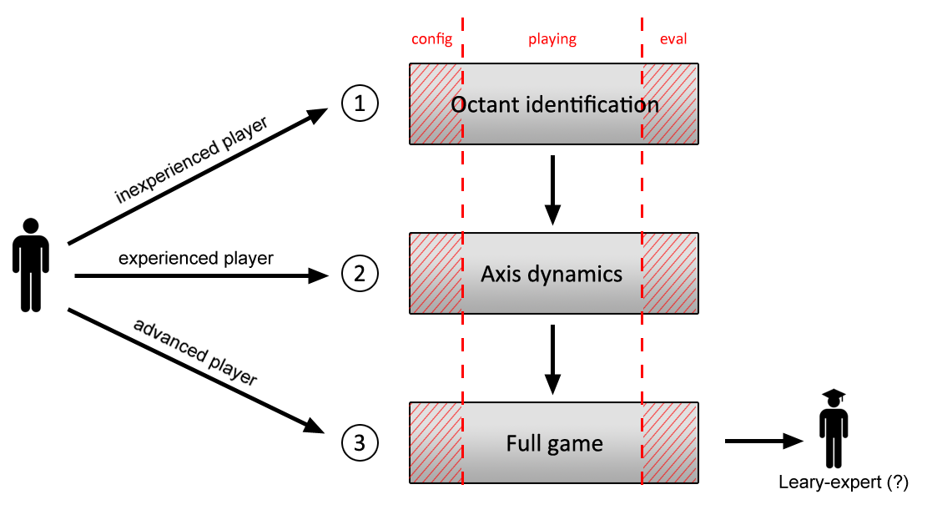
Test Case
Three difficulty levels

Slide 11
Test Case
Which arguments are commonly used?
Any special conversation mechanisms we need to take into account?
How do arguments relate to positions on Leary’s Rose?
Facial expressions, body language, tone of voice?
…
➔ “Wizard of Oz” tests

Slide 12
Test Case
“Wizard of Oz” tests
Results:
State chart of possible arguments and their links
Training set of sentences annotated with their position on Leary’s Rose
audio
video
Player
VA
Actor
text

Slide 13
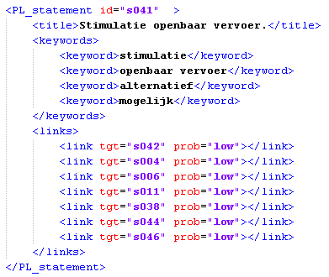
System Architecture
Scenario
Text Input
NLP
Scenario Engine
Audio
Visualization

Slide 14
System Architecture scenario
Scenario
Text Input
NLP
Scenario Engine
Audio
Visualization

Slide 15
SCENARIO
Two lists of statements
VA (virtual actor) statements
PL (player) statements
Stored as XML-file
Pluggable!
New scenarios can be added by non-programmers

Slide 16
SCENARIO VA statementS
Id
Title
One phrasing per octant
One neutral phrasing

Slide 17
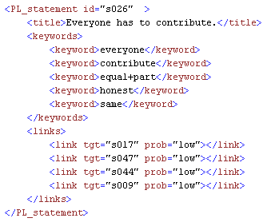
SCENARIO PL statementS
Id
Title
List of keywords
List of possible follow-up VA statements

Slide 18
System Architecture natural language processing
Scenario
Text Input
NLP
Scenario Engine
Audio
Visualization

Slide 19
Natural Language Processing
Two sub-modules:
Leary Classifier determine the position of the player on Leary’s Rose
Topic Detection identify the state corresponding to the user input

Slide 20
Natural Language Processing Leary Classifier
Training Sentences
Parser
Feature Extraction
Training Vectors (with position)
Machine Learner
Model
Training
Test Sentence
Parser
Feature Extraction
Test Vector (no position)
Predicted Position
Testing

Slide 21
Natural Language Processing Leary Classifier
 | Quadrants (+neutral) |  | Octants (+neutral)
 | Accuracy | F-score | Accuracy | F-score
SVM Classifier | 55.0% | 38.0% | 42.6% | 18.5%
Random Baseline | 24.2% |  | 13.0%
Classifier Performance
Relatively low performance
Still well above random
➔ What about humans?

Slide 22
Natural Language Processing Leary Classifier
 | Quadrants (+neutral) | Octants (+neutral)
κ | 0.27 | 0.14
Avg. pairwise overlap | 53.0% | 30.0%
Agreement between 4 annotators on a random conversation
Low agreement between human annotators
Difficult task even for humans
Wizard of Oz conversations worked well despite low agreement

Slide 23
Natural Language Processing Topic Detection
Keyword matching
Every state has its keywords
Defined manually! ➔ Limit amount of manual work
Potential problems:
Synonyms measure != decision
Word forms measures != measure
Negation final != !final
Decision is final
decision, final
“We’re only considering these measures, they’re not yet final.”
Decision is NOT final
decision, !final

Slide 24
Natural Language Processing Topic Detection
Synonyms:
Automatic expansion of words with synonyms and related terms (Cornetto) measure > decision
Word forms
Lemmatization measures > measure
Negation:
Automatic negation detection (based on parser output) final > !final
➔ Broad coverage with a minimum of manual work
Decision is final
decision, final
“We’re only considering these measures, they’re not yet final.”
Decision is NOT final
decision, !final

Slide 25
Natural Language Processing Topic Detection
Further Enhancements
Keyword weights very common, less informative words ➔ lower weight
Linked keywords set+in+stone > final
Result: broad coverage with a minimum of manual work

Slide 26
System Architecture scenario engine
Scenario
Text Input
NLP
Scenario Engine
Audio
Visualization

Slide 27
Scenario Engine
Two main jobs
update current VA Leary-position based on player octant
Based on axis dynamics
Select VA response
Based on links in scenario
Special statements may override links!

Slide 28
Scenario Engine
Special statements
Statement with specific trigger, specific action, or both
Examples
Reaction to insult
Trigger: at least one offensive word in player input
Storm out of the room
Trigger: VA is in negative octant, player has pushed in wrong direction multiple times
Action: play “storming out” animation and end conversation

Slide 29
System Architecture audio
Scenario
Text Input
NLP
Scenario Engine
Audio
Visualization

Slide 30
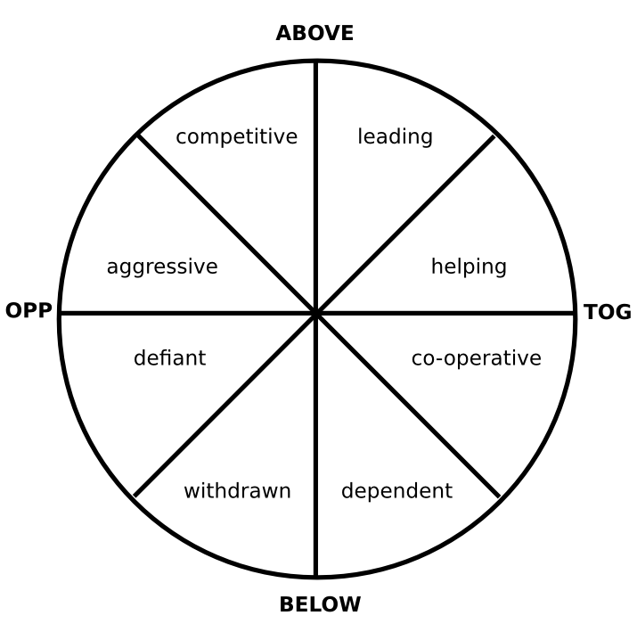
Audio
Professional actor used to record all statements
Extra work, but also extra benefit
The reply of the VA is played in his current Leary octant
Problem: sudden changes of position
Solution: use neutral phrasing when close to center of Rose
P₁
P₂

Slide 31
System Architecture visualization
Scenario
Text Input
NLP
Scenario Engine
Audio
Visualization

Slide 32
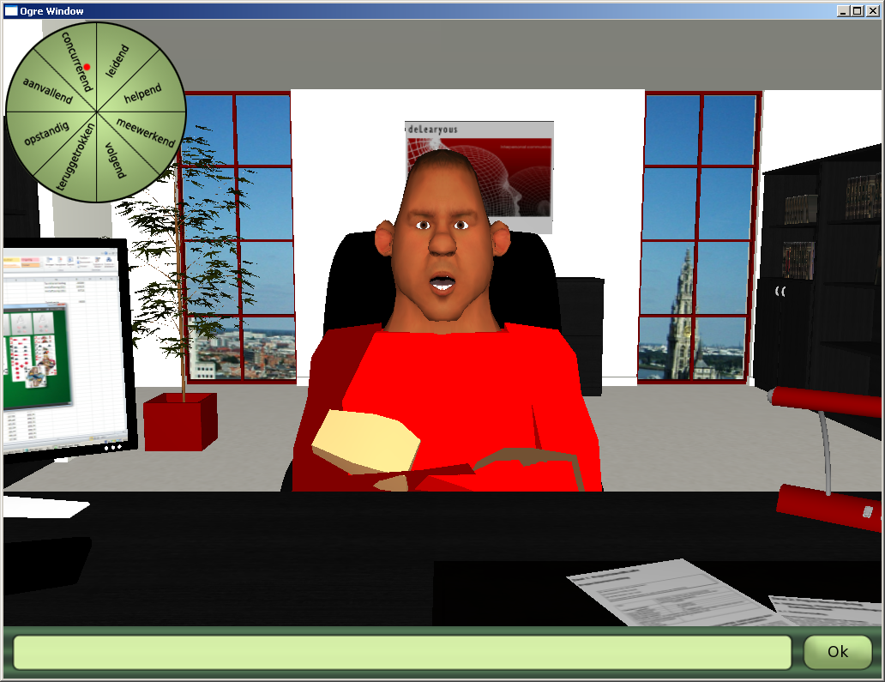
VISUALIZATION

Slide 33
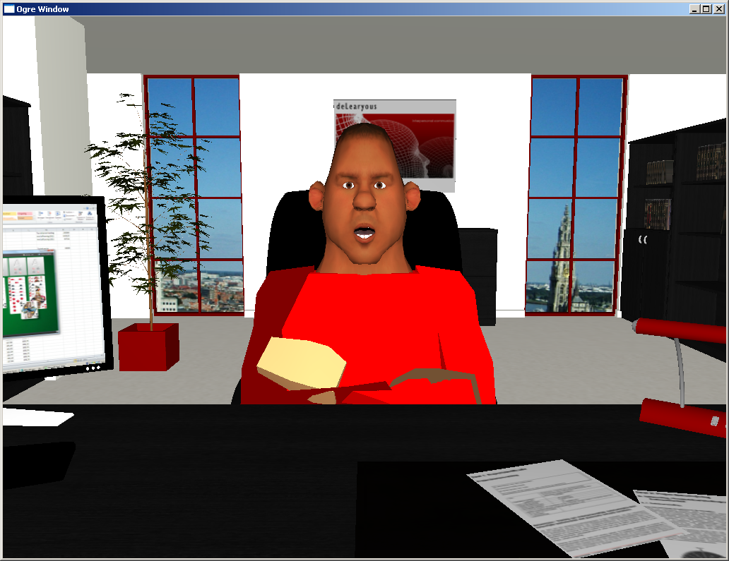
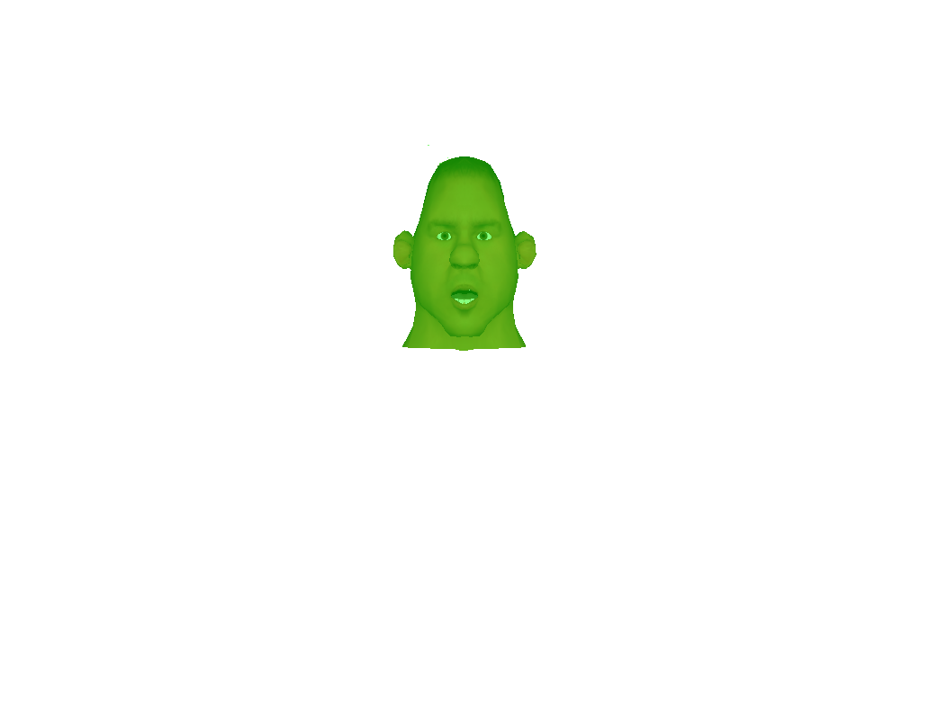
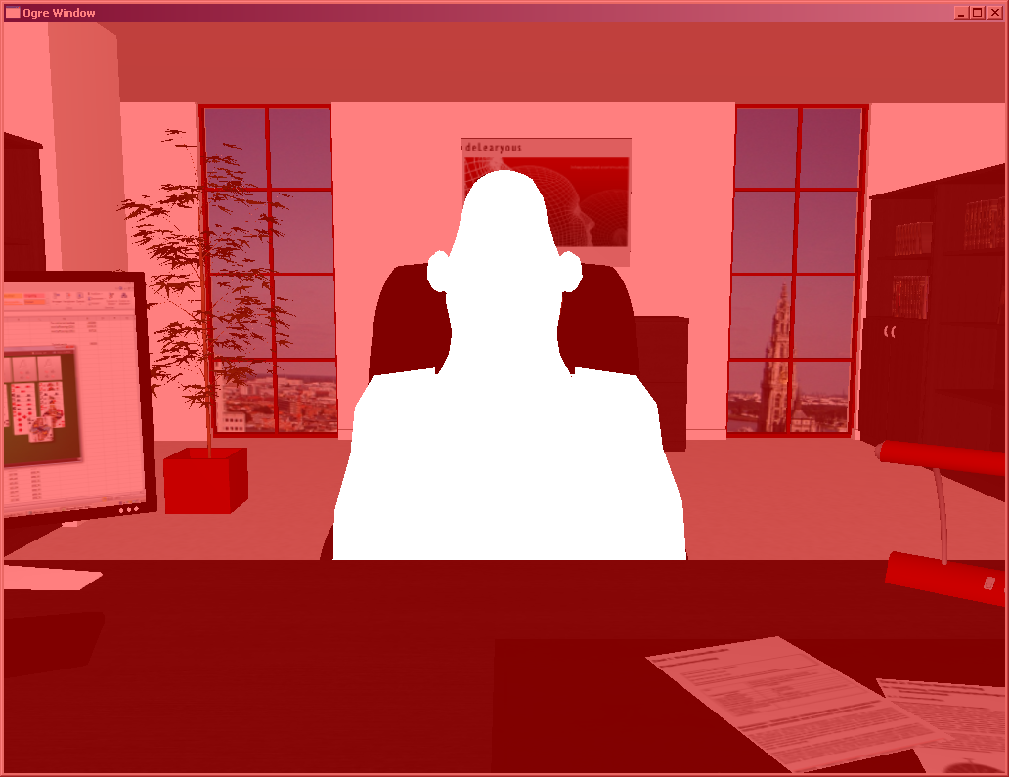
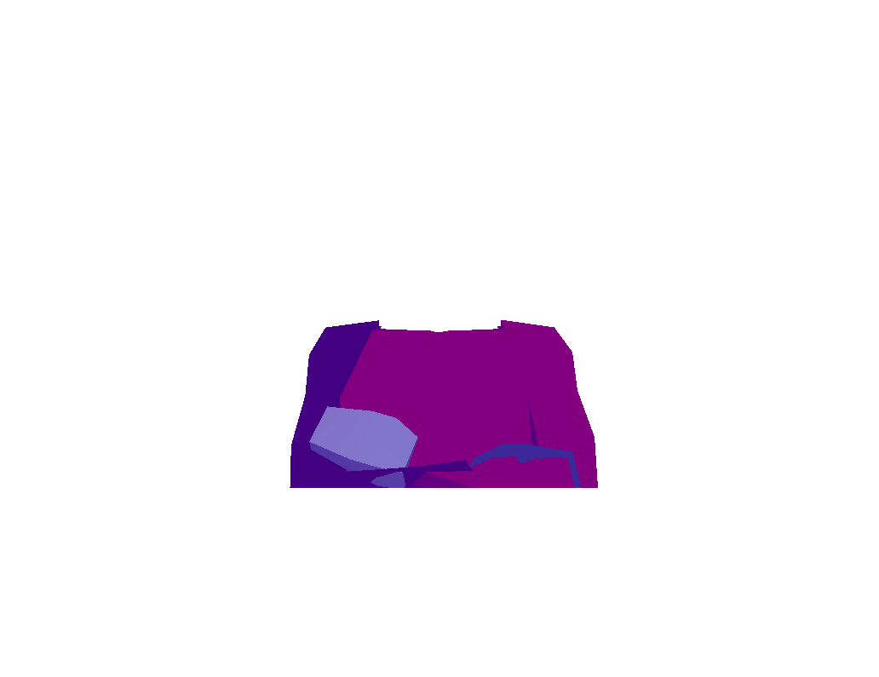
VISUALIZATION
Head
Body
Background

Slide 34
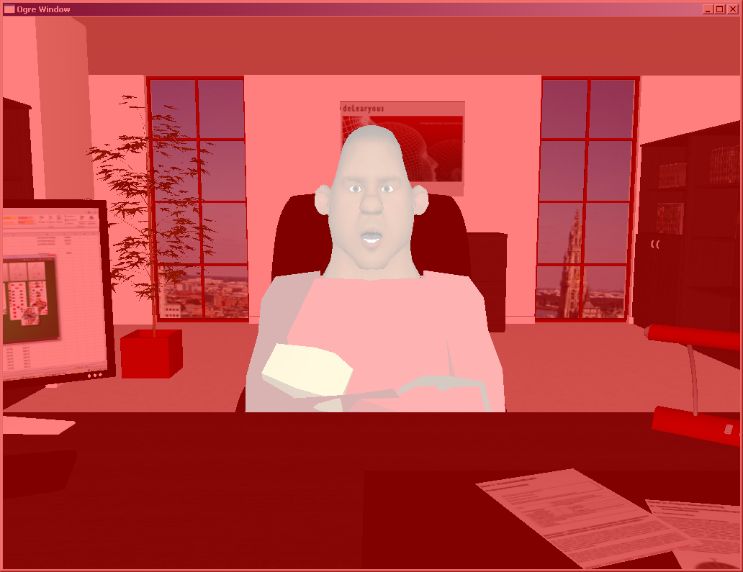
VISUALIZATION background
Visual style adjustable to in-house company style
Color scheme configurable through scripts
Logo and paper textures can adapted
Result:

Slide 35
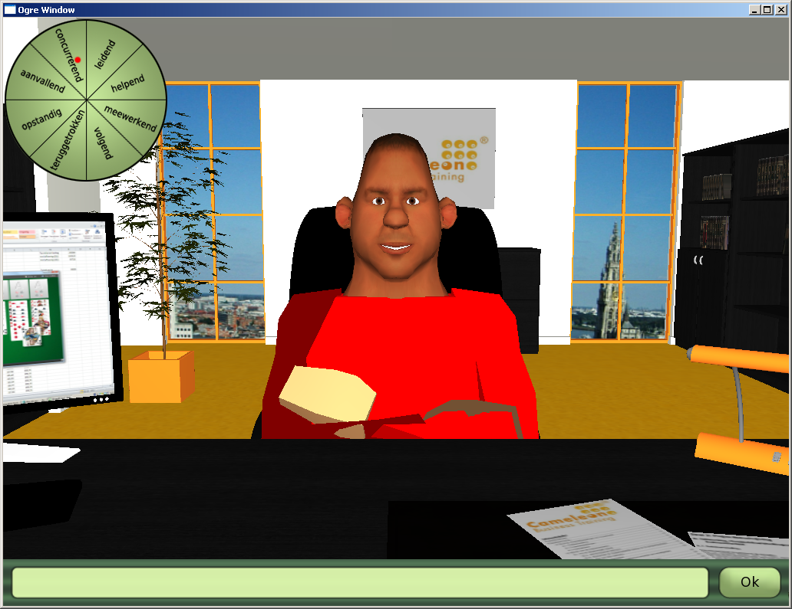
VISUALIZATION background
Result

Slide 36
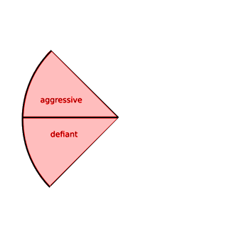
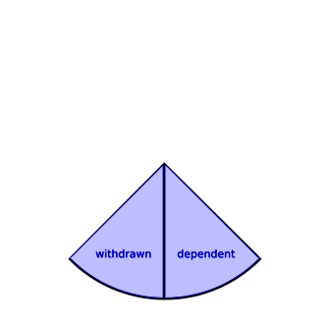
VISUALIZATION body
Map body positions to Circumplex
Examples:
Lean forward
Arms crossed
Lean backward
Avoid eye contact

Slide 37
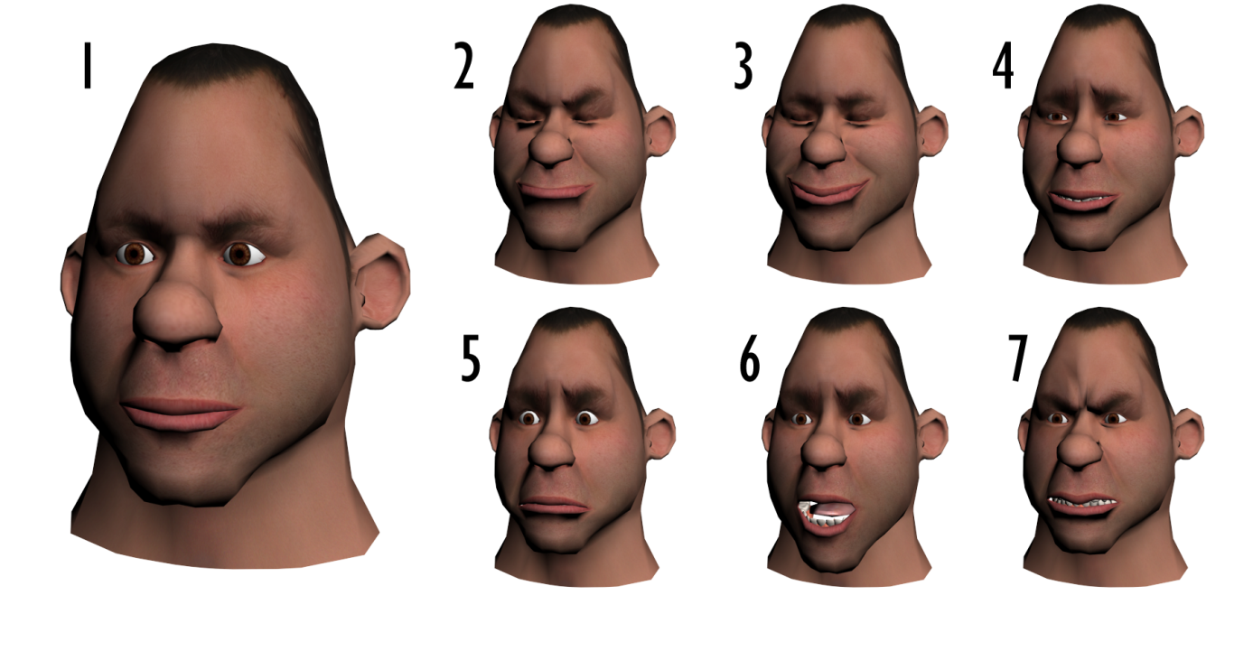
VISUALIZATION FACE
Map facial expressions (6 basic emotions) to Circumplex
Lip Synchronization
1 Neutral
2 Disgust
3 Happiness
4 Sadness
5 Fear
6 Surprise
7 Anger

Slide 38
Future Work
Further improvements in NLP and Scenario Manager
Focus testing
Technical
How natural did the conversation feel?
Influence of erroneous Leary classifications?
Influence of wrong topic matches?
Learning goals
Can the player learn anything from playing the game?
How much human supervision is required?

Slide 39
Contact:
frederik.vaassen@ua.ac.be jeroen.wauters@groept.be

